Slide 1
Tale Tuners

Slide 2
Group-12
Suguna Garmidi - 11667555 (Scrum Master)
Shravya Kandukuri - 11698456
Sagara Pravalika Garlapati - 11592528
Tharuni Sri Reddy Gangaram - 11706904
Hrithik Reddy Ravulapalli - 11709725
Sai Krishna Kanth Bandi - 11708632
Sai Venkat Raparthi - 11653770

Slide 3
SOFTWARE VISION
This Web application is specifically designed FOR kids WHO are far away from their loved ones, particularly their parents, and experience a longing for their presence and love. THE “Tale Tuners” is a personalized web-based application/service provider THAT helps to listen to bedtime stories from the voice of their parents. UNLIKE the existing audiobooks, OUR web application allows the users to upload their recorded voice which can be accessed by their kids at any time from any location.
This “Tale Tuners” fosters strong emotional connections between kids and their parents, even when they are physically distant from each other. Our web application offers unique profile creation for each user and user suggestions for stories based on their favorite genre.

Slide 4
User Stories
1. Profile Creation and login: As a Parent(new user), I want to create a profile on the platform, so that I can access personalized features and services.
As a child, I want to log in to the parent-created profile, so that I can access and listen to the already uploaded recordings.
2. Genre Selection: As a parent or guardian, I want to introduce my child to a variety of genres, so that they can develop diverse reading interests and expand their imagination.
3. Options: As a parent, I want to view the options available, whether it is a voice recording option or there any recorded voice so that I can select the option I need.
4. Displaying Story: As a Parent, I want to view the story details such as ( Title, cover page) of a selected book, so that I can introduce my child to a variety of preferences.

Slide 5
5. Record Voice: As a parent, after choosing the options, I want to record stories with my voice(the voice of the loved ones), so that my child can access and listen to the stories.
6. Time Restrictions: As a Parent, I want to set a timer, so that the child can be notified of the listening time. And can listen to the recordings and sleep at the right time.
7. Folder of Favorites: As a parent, I want to add the stories that my child likes the most into a favorites folder so that I can view or play those books whenever I need them.
8. Suggestions: As a reader/parent looking for new books, I want to explore suggestions based on the most played books, so that I can find captivating stories that resonate with my child’s interest.
As a parent, I want to be able to select a suggestion from the list and have it automatically populate the search box, so that I can save time and effort in typing.
As a parent, I want to see the loading spinner or progress indicator while the suggestions are being fetched, so that I know the system is working on providing me with the suggestions.

Slide 6
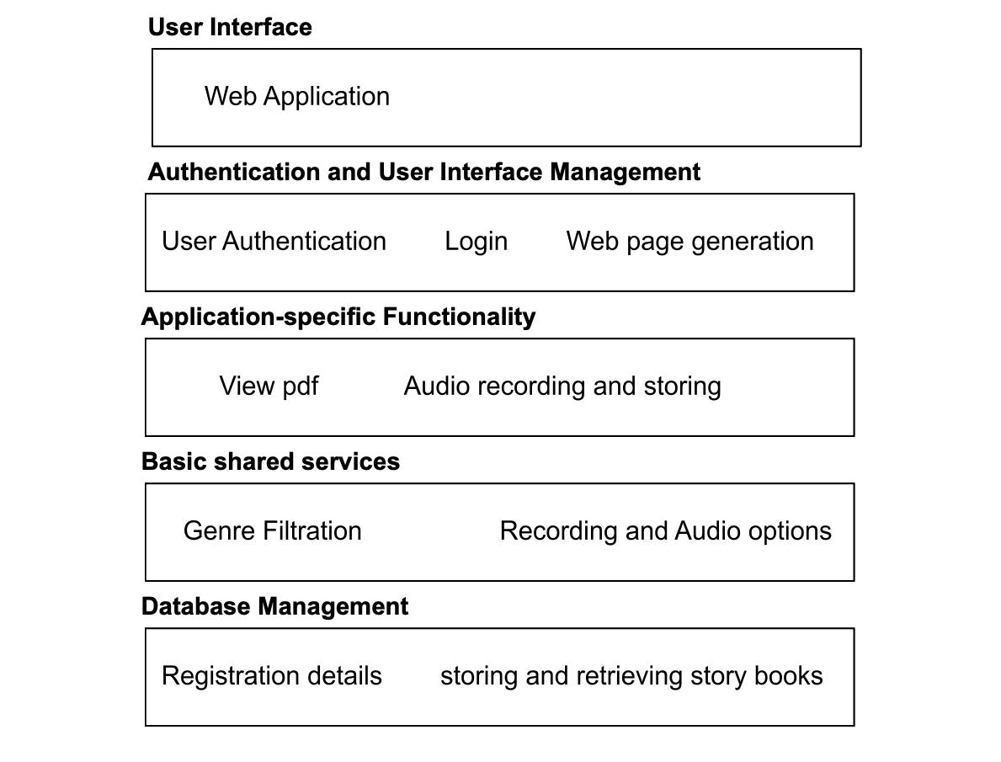
Software Architecture

Slide 7
ARCHITECTURE OF SOFTWARE:
Web-Based Interface
We are working on a Web-based application in which the various HTML forms and CSS are used for creating user signup and login pages. Also, working on Java script for user input validations.
Authentication and User Interface Management
A User Authentication Layer is developed for validating user information. Basically, the login page generates the other web pages only if the user mentioned login details validates with the signup details.
Application-specific Functionality
This layer defines functionality of the software application. Also, application layer can even be defined into more than one layer. We added a few application-specific layers for our website such as a View story PDF layer for viewing the story book, Audio recording layer for recording the voices and Audio storing layer for storing the audios into the Database.

Slide 8
Basic shared services
We have included several services based on our project. Genre Filtration service which includes displaying various books based on the the genre selected by the user.
Transaction and Database Management
A Database layer was added for storing and retrieving the story Books and audio files from the database.

Slide 9
Issues Faced
In sprint 1, we encountered challenges while working on the "forgot password" implementation, which proved to be a more complex task than anticipated. As a result, we had to postpone it to sprint 2.
During sprint 2, we encountered various bugs related to displaying stories and the functionality of the "view story". Fortunately, these issues did not hinder the progress of our other user story implementations.
Github Repo Link:- https://github.com/sugunagar/Tale-Tuners-Group-12/projects?query=is%3Aopen

Slide 10
Experiences and Suggestions
Sprint Meetings
Teamwork
Time Management
Planning and Reviewing
GitHub Repository
Use Branches
Pull Requests
Collaboration

Slide 11

Demo

Slide 12
THANK YOU
TEAM TALE TUNERS
👫👬👭👫

